Slide 1

Q&A with C#
#3: Collections
#4: Dependency Inversion Principle (SOLID)

Slide 2

Collections in C#

Slide 3
Everything is… array

Slide 4
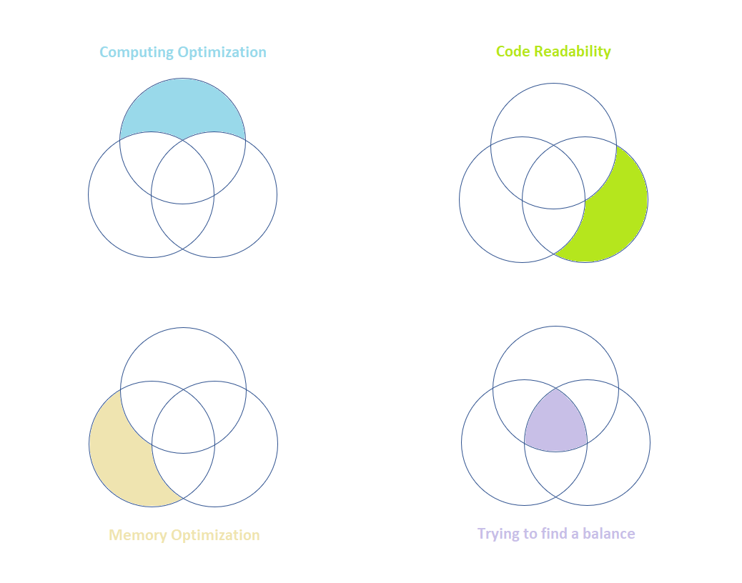
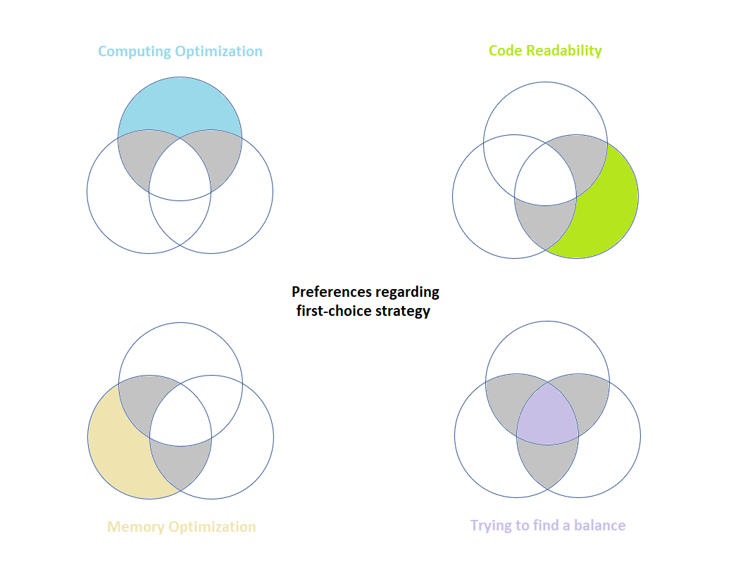
Different priorities in software
Realistically saying, this is impossible

